Slide 1
Impact of
SOCIAL MEDIA
ALGORITHMS ON YOUTH BEHAVIOR

Slide 2


Welcome!
“Today we will discuss the Impact of Social Media Algorithms on youth life and how they shape online experiences.”
Vedhavathi Y A
Surabhi
01SU24CS167
01SU24CS155
Srinivas University Institute Of Engineering & Technology, Mukka.
Srinivas University Institute Of Engineering & Technology, Mukka.

Slide 3
Agenda
01
03
05
INTRODUCTION
What are Social
Media Algorithms
Real-Life Effects &
How to Minimize Negative Impact
02
04
06
Problem Statement
Positive & Negative Impact of Social Media Algorithm.
Conclusion & References

Slide 4

INTRODUCTION
Social media platforms are widely used by youth worldwide.
Platforms such as Instagram, Facebook, and YouTube
use algorithms to recommend personalized content.
These algorithms analyze user activities like likes,
shares, comments, and watch time.
Continuous exposure to recommended content may
Influence the opinions, interests, and behavior of
young users.
This study analyzes how social media algorithms affect
youth behavior and decision-making.

Slide 5
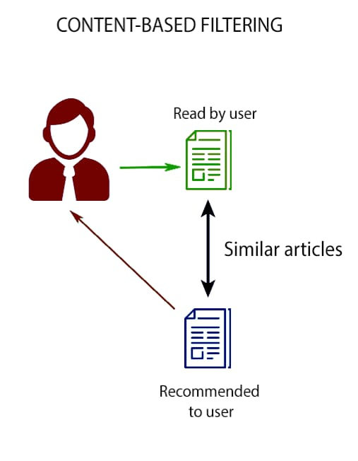
Problem Statement
Social media usage among youth is increasing rapidly.
Social media platforms use algorithms to recommend content.
Continuous exposure to recommended content may influence youth behavior and lifestyle.

Slide 6
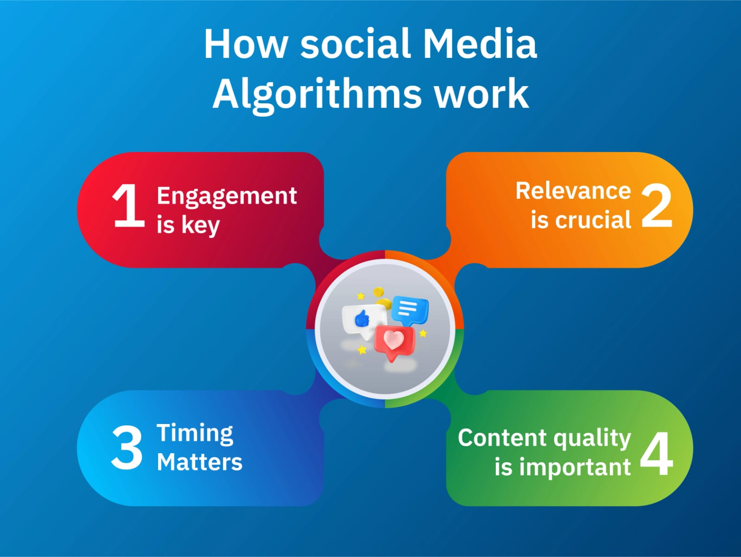
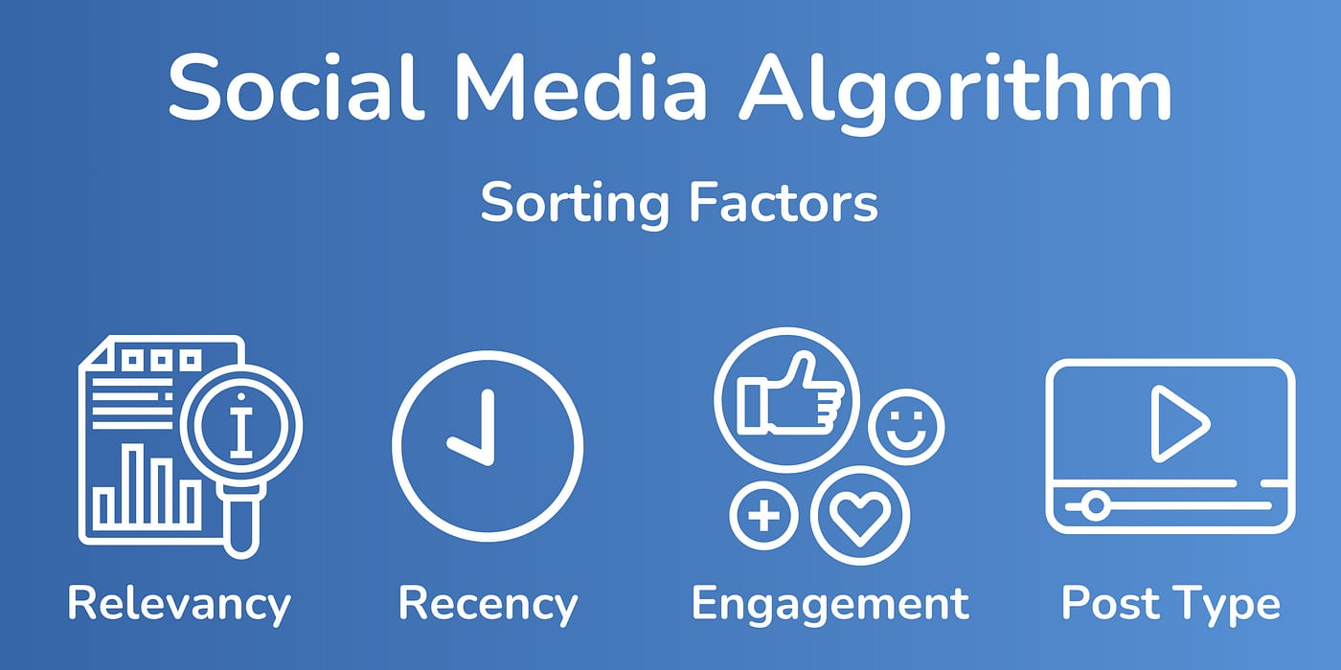
What are Social Media Algorithm.
Algorithms decide what content appears on your social media feed.
They personalize content based on your likes, shares, and interactions.
Aim to keep users engaged by showing content you are likely to watch or like.

Slide 7

Positive Impacts of Social Media Algorithms
Helps youth connect with friends and communities easily.
Shows personalized content for learning, hobbies, and interests.
Keeps users aware of trends and global events.

Slide 8
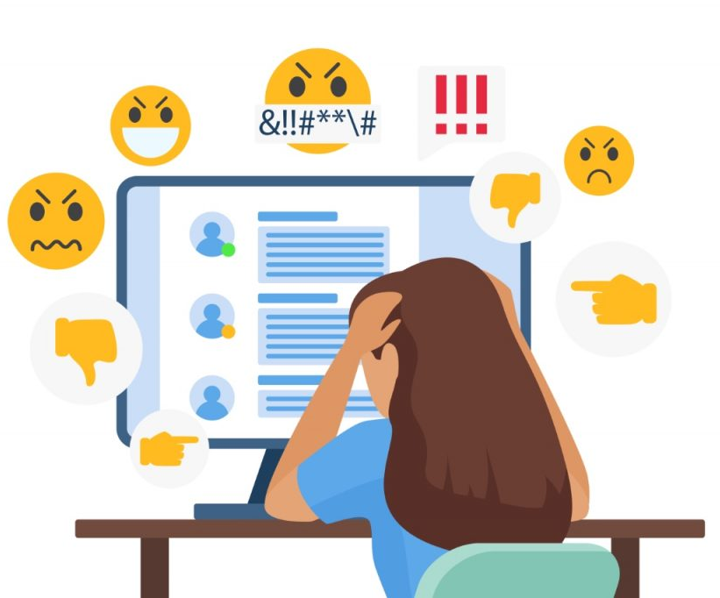
Negative Impacts of Social Media Algorithms
Can cause addiction and excessive screen time.
May lead to anxiety, low self-esteem, and social comparison.
Spreads misinformation and privacy concerns.

Slide 9
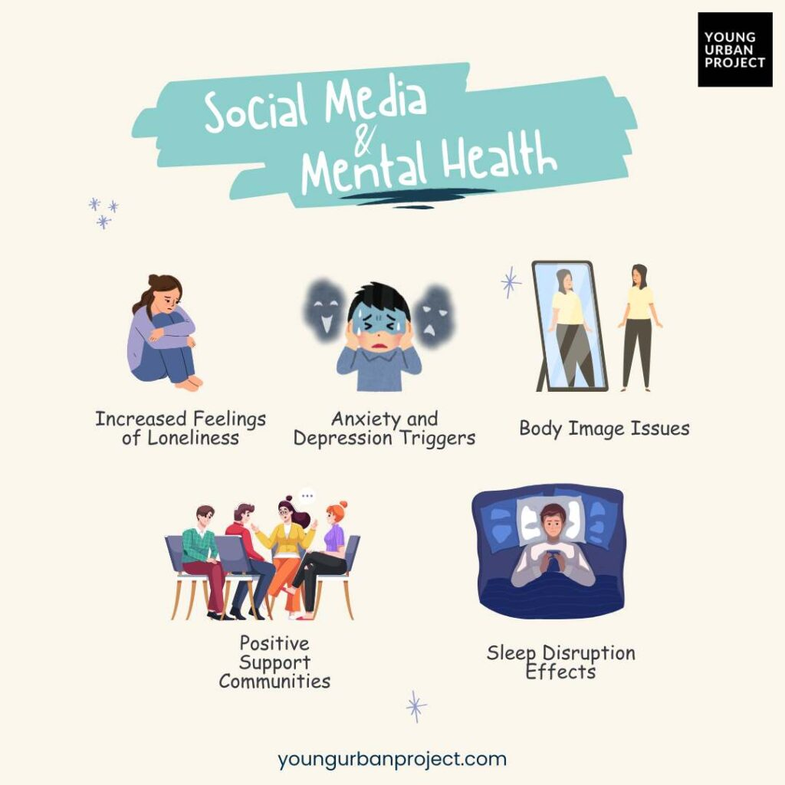
Real-life Effects on Youth
Sleep disruption and reduced focus on studies due to late-night scrolling.
Peer pressure and social comparison affecting confidence.
Pressure to gain likes/followers
→ mental stress and anxiety.

Slide 10
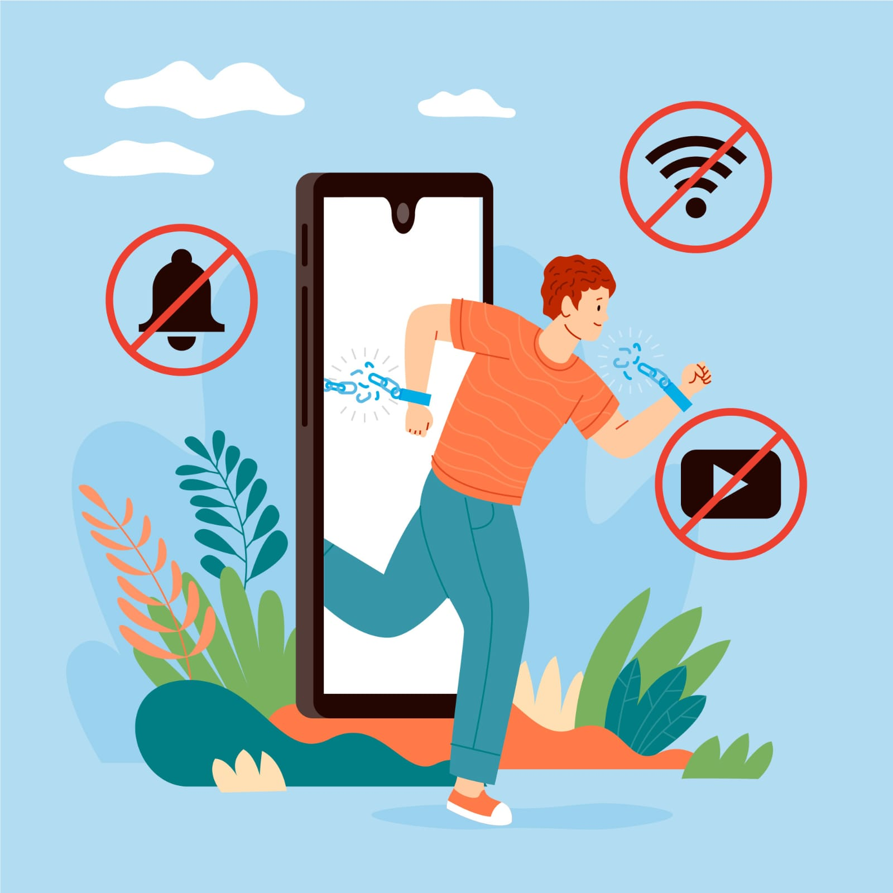
How to Minimize Negative Impact
Limit screen time and take regular breaks from social media.
Follow positive and educational content instead of only trends.
Be aware of algorithm influence on your mood and decisions.

Slide 11
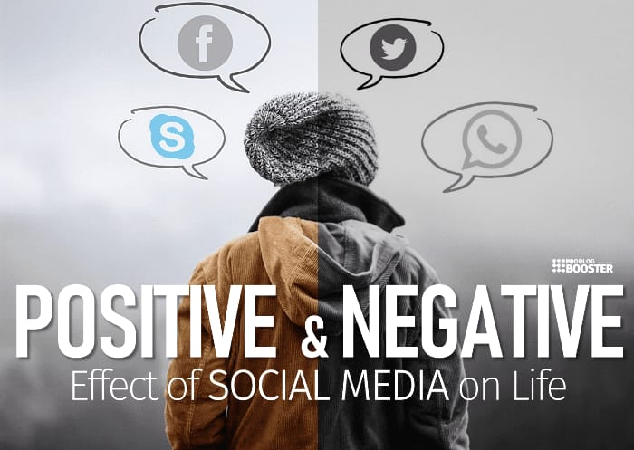
Conclusion
Social media algorithms affect youth both positively and negatively.
Awareness and responsible usage are key to a healthy digital life.
Balance between online engagement and real-life activities is essential.

Slide 12
References
Smith, J. (2023). Impact of Social Media on Youth Mental Health. Social Science Journal.
Patel, R. (2022). Understanding Social Media Algorithms. Tech Review Online.
Kumar, A. (2021). Digital Habits of Teenagers. Youth Studies Report.
UNICEF. (2022). Youth and Digital Media: Opportunities and Risks. www.unicef.org⁠�

Slide 13
Any Questions?
“We would be happy to answer any questions you have about
our presentation.”

Slide 14
Thank
You!

